Slide 1
Chapter 17 – Growth Responses in Plants

Slide 2
17.1 Growth Movements in Plants in Response to Stimuli
You should be able to:
■ describe the response of green plants to unilateral stimuli of light and gravity.

Slide 3
17.1 Growth Movements in Plants in Response to Stimuli
Plants exhibit several characteristics of living things such as growth, response to stimuli and adaptation.
However, plants cannot migrate if living conditions required for growth and survival are not optimal.
Plants can only change their growth such that they will ‘move’ towards the appropriate direction where favourable conditions are found.
These growth movements, known as tropisms, occur in a certain direction in response to the direction from which the stimulus strikes the plant.

Slide 4
17.1 Growth Movements in Plants in Response to Stimuli
Tropism
Plants show several different types of tropisms. The response of plants to light is called phototropism and the response of plants to gravity is called geotropism.
Tropism can be positive, where the plant, or part of it, grows towards the stimulus, or negative, where growth occurs away from the stimulus.
Tropism is important as it allows plants to respond to changes in the environment.

Slide 5
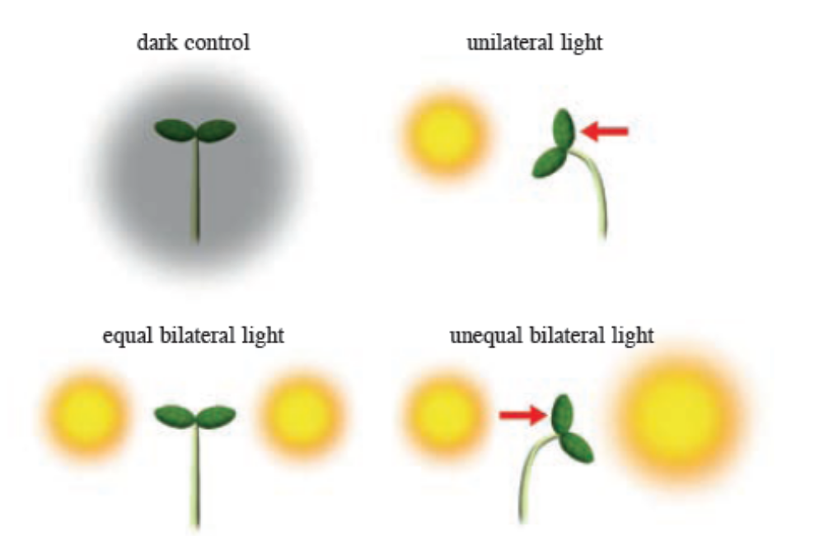
17.1 Growth Movements in Plants in Response to Stimuli
Phototropism directs plants to grow towards the light so they can make food by photosynthesis. The shoots display positive phototropism while the roots display negative phototropism.
Phototropism in plants

Slide 6
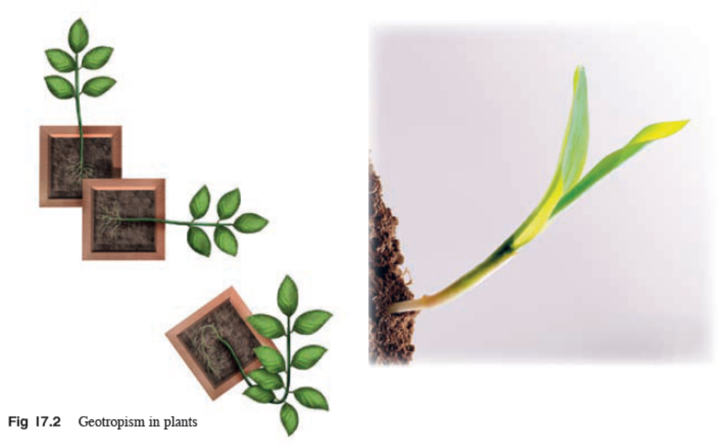
17.1 Growth Movements in Plants in Response to Stimuli
Geotropism directs plants to manoeuvre themselves to an upright position even if they are placed aside or upside down in the soil. The shoots display negative geotropism to grow upwards, towards the sunlight, while the roots display positive geotropism, in the direction of gravity towards moisture and dissolved minerals in the soil.

Slide 7
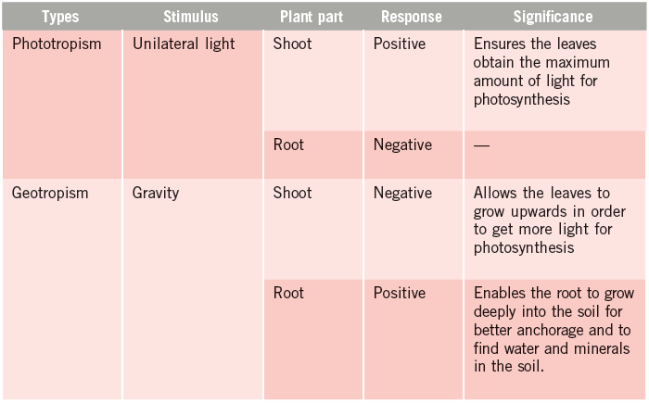
17.1 Growth Movements in Plants in Response to Stimuli

Slide 8
17.2 Control of Growth and Development in Plants
You should be able to:
■ state the functions of plant growth substances and auxins in controlling growth and development in plants; and
■ perform simple investigation to demonstrate growth in living organisms.

Slide 9
17.1 Control of Growth and Development in Plants
Growth is defined as the increase in the number of cells in an organism, which results in an irreversible increase in mass.
Development is defined as an increase in complexity of the organism, as the cells differentiate into tissues and carry out specific functions.

Slide 10
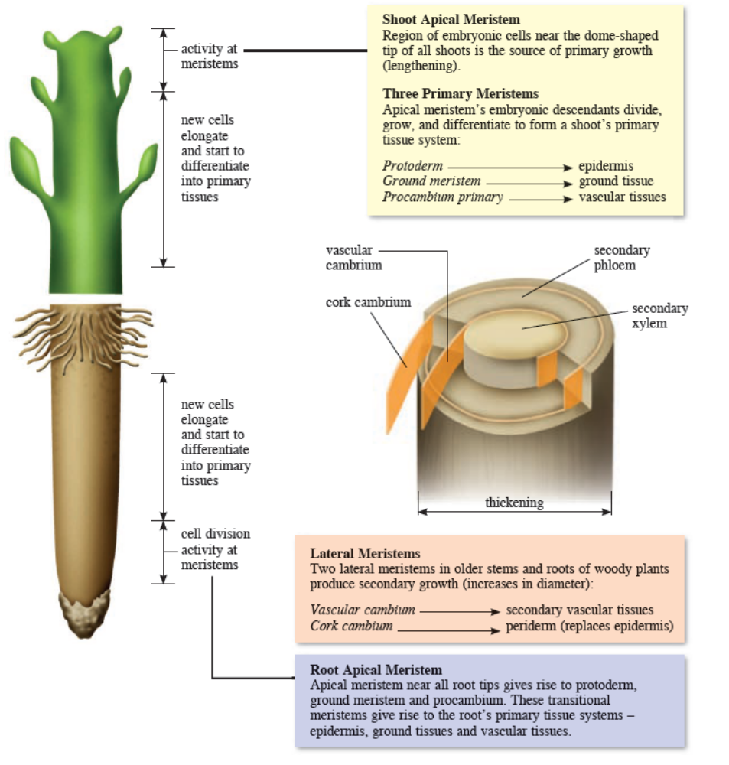
17.1 Control of Growth and Development in Plants

Slide 11
17.1 Control of Growth and Development in Plants
A major difference in the growth between plants and animals is that plant growth does not stop after reaching a certain size.
Instead growth takes place throughout the plant’s life, a process called indeterminate growth.
Cells located just below the tips of roots and shoots enable the plant to grow as a result of both cell division and cell expansion. These cells are found in tissues called meristems.

Slide 12
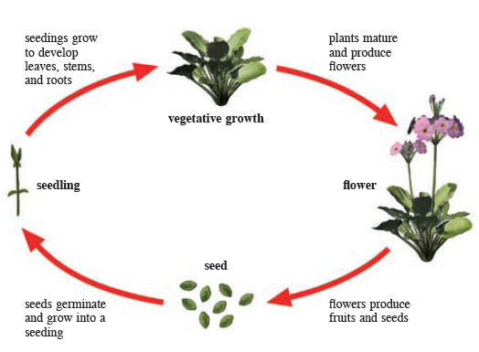
17.1 Control of Growth and Development in Plants
A general plant life cycle

Slide 13
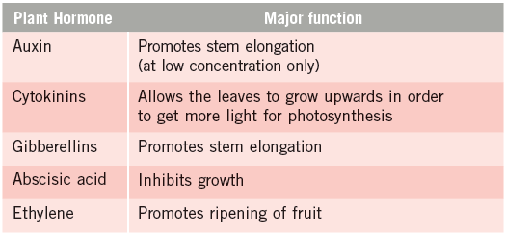
17.1 Control of Growth and Development in Plants
Growth responses in plants are caused by plant hormones or growth promoting substances. Plant hormones help coordinate growth, development and responses to stimuli by affecting cell division, elongation and differentiation.

Slide 14
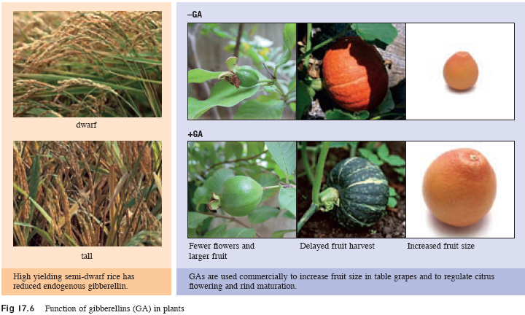
17.1 Control of Growth and Development in Plants

Slide 15
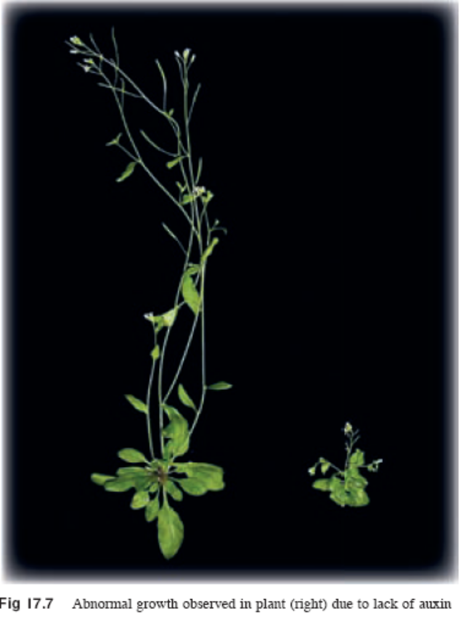
17.1 Control of Growth and Development in Plants

Slide 16
17.1 Control of Growth and Development in Plants
Auxin and Tropism
The tropic responses of plant are regulated by a group of plant growth hormones known as auxins. Auxins are mainly produced at the tips of shoots and roots and are transported to the region of elongation where they regulate the process of cell elongation.
Auxins can either stimulate or inhibit growth in plants.
Unequal distribution of auxin at the tips of roots and shoots causes differential growth of these cells.
High auxin concentration promotes shoot growth, but inhibits root growth.
Very high auxin concentrations inhibit both root and shoot growth.

Slide 17
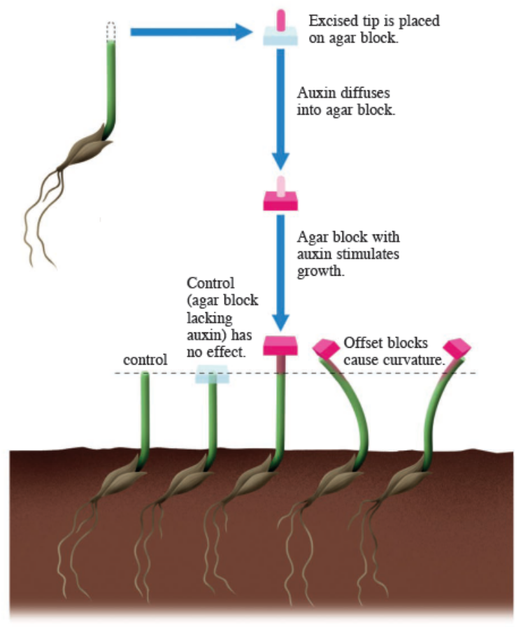
17.1 Control of Growth and Development in Plants
The following experiment can be carried out to show how auxin promotes stem elongation.
Auxin is found at the shoot tip
Auxin is a diffusible chemical substance.
The tropic response of plants is due to auxin.
Diffusion of auxin on one side of the shoot causes cell elongation, thus bending the shoot.

Slide 18
17.1 Control of Growth and Development in Plants
Phototropism
Under conditions where there is no light or uniform light distribution, equal distribution of auxin gives even growth and the shoot grows straight upwards.
With unilateral light stimulus, distribution of auxin becomes unequal, thus giving unequal growth.
Auxin diffuses to the shaded side of the shoot, causing the cells there to grow faster than the cells on the other side of the plant. This causes the plant stem to tip towards the light.

Slide 19
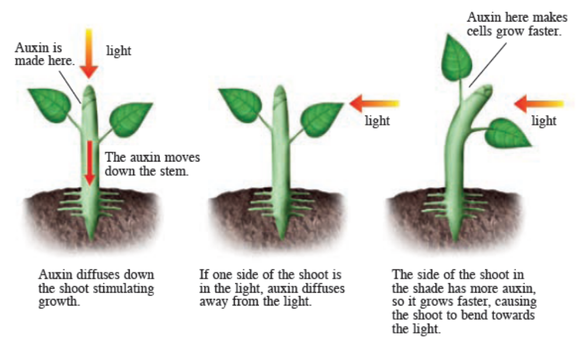
17.1 Control of Growth and Development in Plants
Phototropism shown by the shoot of a seedling

Slide 20
17.1 Control of Growth and Development in Plants
Geotropism
When the plant is placed horizontally, auxin which is produced at the shoot and root tip diffuses towards the lower side because of gravity.
Thus the shoot bends upward and the root curves downward.
Geotropism is significant to germinating seeds as it ensures that the root grows into the soil and the shoot grows towards the sunlight, regardless of how the seed is oriented when it lands.

Slide 21
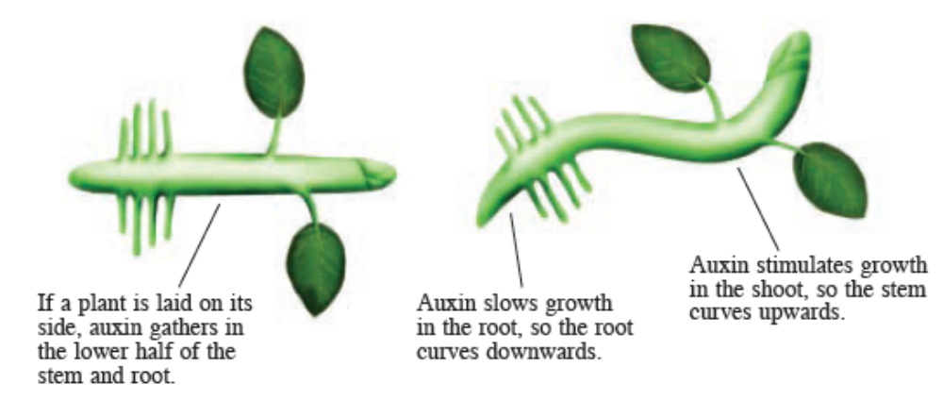
17.1 Control of Growth and Development in Plants
Geotropism in the shoot of a seedling

Slide 22
17.1 Control of Growth and Development in Plants
Growth in Plants
Growth leads to a permanent increase in size and mass of an organism.
There are several ways to demonstrate growth in plants. Here are some ways to measure the growth in plants.
  Measuring changes in length or height of plant
  Measuring changes in mass of the entire plant
  Measuring the changes in surface area of the leaves or roots
  Counting the number of leaves in a plant
  When conducting experiments to measure the growth, always measure from a number of seedlings and calculate the average. This is a more accurate indication of growth.

Slide 23
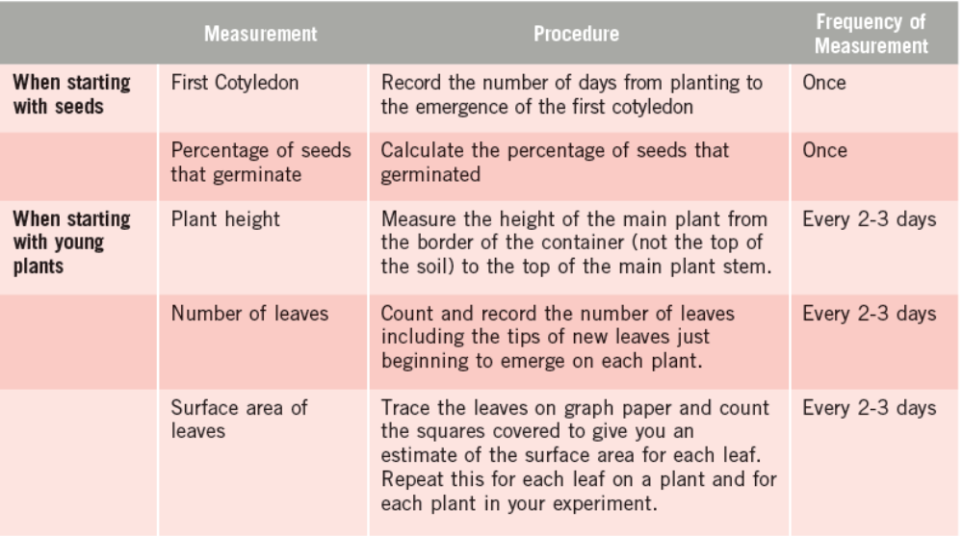
17.1 Control of Growth and Development in Plants

Slide 24
Key Concepts
Tropism is a directional growth movement of plants in response to unilateral stimulus.
Tropism can be positive, where growth occurs towards the stimulus or negative, where growth occurs away from the stimulus.
The response of plants to light is called phototropism and the response of plants to gravity is called geotropism.
Phototropism directs plants to grow towards the light so that they can make food by photosynthesis.
The shoots of plants display positive phototropism, while the roots display negative phototropism.
Geotropism directs the roots of plants towards moisture and dissolved minerals in the soil. The shoots of plants display negative geotropism to grow upwards, towards the light, while the roots display positive geotropism, to grow downwards, in the direction of gravity.

Slide 25
Key Concepts
Phototropism and geotropism are caused by auxins, which are mainly produced at the tips of shoots and roots. They promote elongation of cells within shoots.
Unequal distribution of auxin at the tips of roots and shoots causes differential growth of these cells.
High auxin concentration promotes shoot growth, but inhibits root growth. Very high auxin concentrations inhibit both root and shoot growth.
Growth leads to a permanent increase in size and mass of a living organism. It can be measured by changes in length, mass or surface area using roots or leaves, or counting the number of leaves in a plant.

